Slide 1
Comparative Analysis of Sentiment Analysis Models
Fadi Awawdeh
Notes:
Today I’ll present my project comparing different sentiment analysis approaches — from rule-based methods to classical machine learning and transformer-based models — across three benchmark datasets

Slide 2
Motivation
01
Sentiment analysis is widely used
02
Many competing model paradigms
03
Trade-offs: accuracy, cost, interpretability
Notes:
Sentiment analysis is one of the most common NLP tasks in industry. However, there’s a tension between using complex models like transformers and simpler models that are faster and easier to interpret

Slide 3
Research Gap
Prior work focuses on single paradigm
Few controlled comparisons
Often single dataset
Notes:
Most existing work focuses on either classical methods or deep learning in isolation. Very few studies compare these approaches systematically under the same experimental conditions

Slide 4

Research Questions
How do rule based, classical supervised machine learning and transformer based models differ in accuracy and efficiency for sentiment classification across multiple datasets?
Notes:
How do models compare under identical conditions?
How does dataset size affect performance?
When is complexity justified?

Slide 5
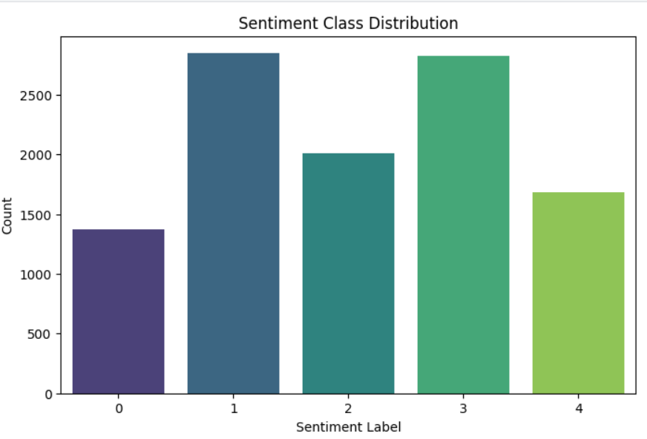
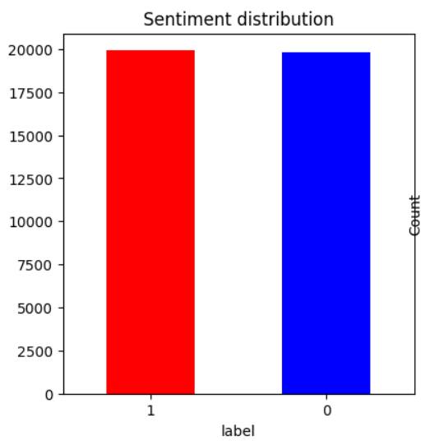
Datasets
SST
Dataset | Size | Classes
IMDB | 40k | Binary
SST-5 | ~11k | 5-class
Amazon polarity | ~35Million | Binary
IMDB
Notes:
hese datasets allow us to test models across different scales and sentiment granularities

Slide 6
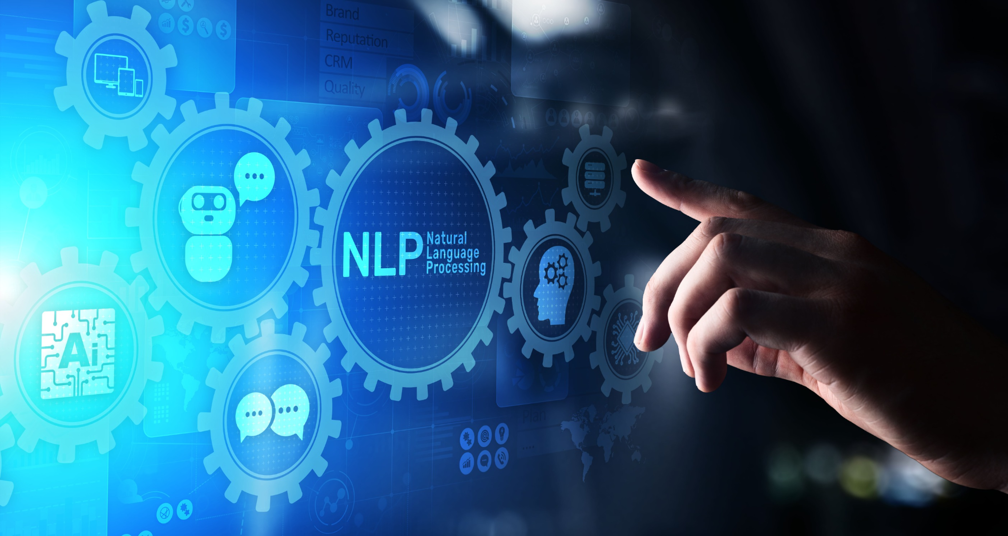
Models Evaluated
01
Rule-based: VADER
02
Classical ML: Logistic Regression, Naive Bayes
03
Transformer model:RoBERTa
04
Deep Learning: 1D CNN
Notes:
This covers the full spectrum — from no training at all to large pre-trained transformer models

Slide 7
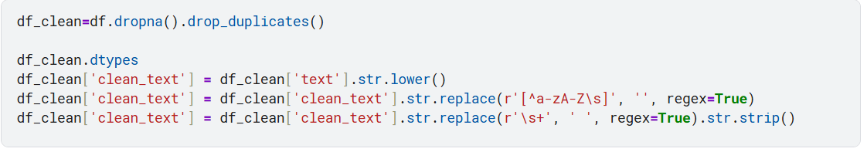
Experimental Setup
Same train/test splits
Same metrics
Hyperparameter tuning applied
Notes:
To ensure fairness, all models were evaluated using the same splits and metrics, with hyperparameter tuning applied where appropriate

Slide 8
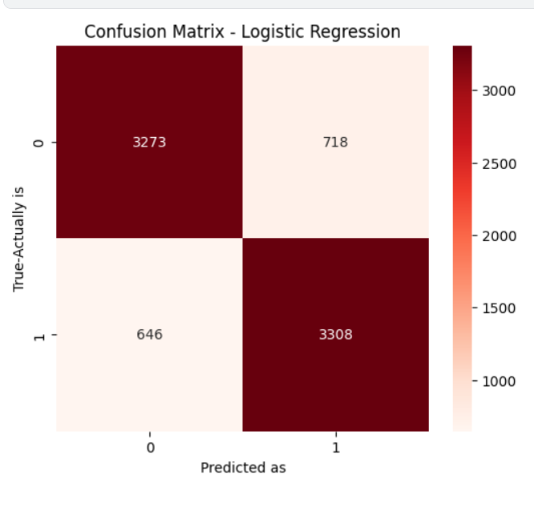
IMDB Results
Logistic Regression : 93%
RoBERTa : ~88%
VADER: ~68%
1D-CNN: ~85%
Notes:
1. TF–IDF + Logistic Regression remains the strongest classical approach (96%).
2. RoBERTa fine-tuning would likely exceed 95–97%.
3. VADER is unsuitable for long movie reviews.
4. CNNs improve but still fail to match classical models on medium-sized datasets.

Slide 9
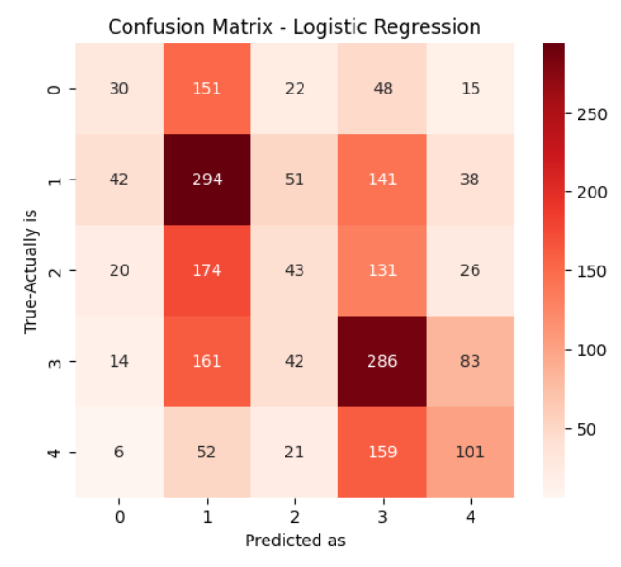
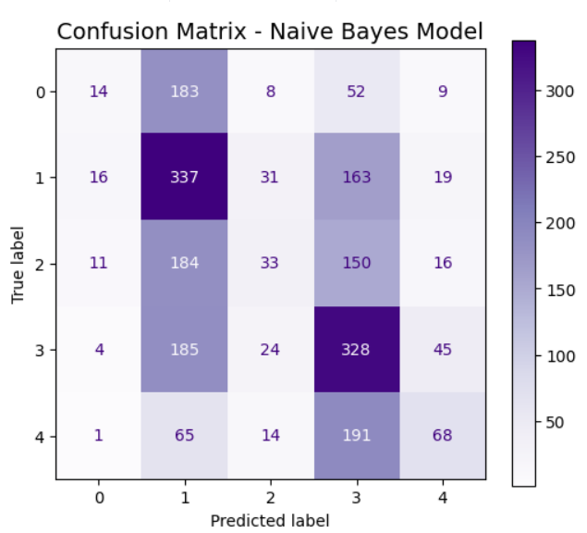
SST-5 Results
VADER: ~20%
Classical ML: ~70–89%
RoBERTa: ~90%
1-D CNN: 40%
Notes:
SST-5 fundamentally changes the picture. Fine-grained sentiment requires contextual understanding, where transformers clearly outperform simpler methods.:
1. Hyperoptimized NB convincingly outperforms all classical models.
2. RoBERTa remains the best overall, but ComplementNB is surprisingly competitive.
3. CNNs perform poorly due to dataset size & fine-grained difficulty.
4. VADER should not be used for multi-class or subtle polarity tasks.

Slide 10
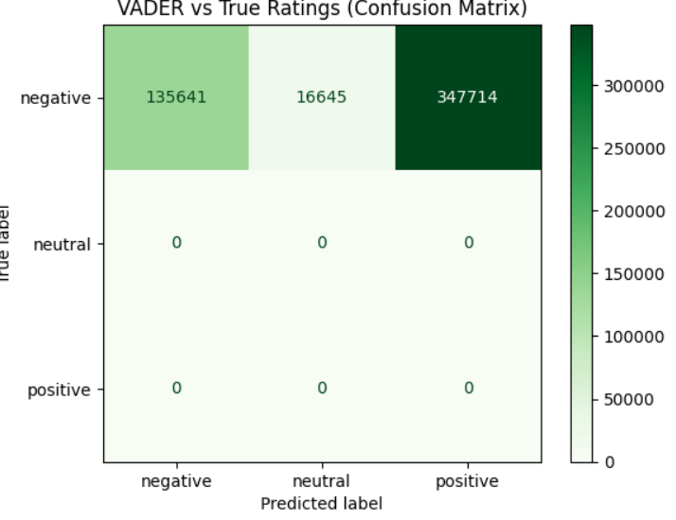
Amazon Dataset
Logistic Regression: ~96%
Naive Bayes:~92%
Vader: ~65%
RoBERTa: ~92–94%
CNN: ~90%
Notes:
With enough data, classical models reach near-ceiling performance, offering little room for transformers to improve

Slide 11

Performance vs cost
Model | Accuracy | Cost
Logistic Regression | High | Low
Vader | Low | Low
Naive Bayes | High | Low
1-D CNN | Medium | Medium
RoBERTa | High | Very high
Notes:
This trade-off is critical for real-world deployment, where cost and latency matte

Slide 12
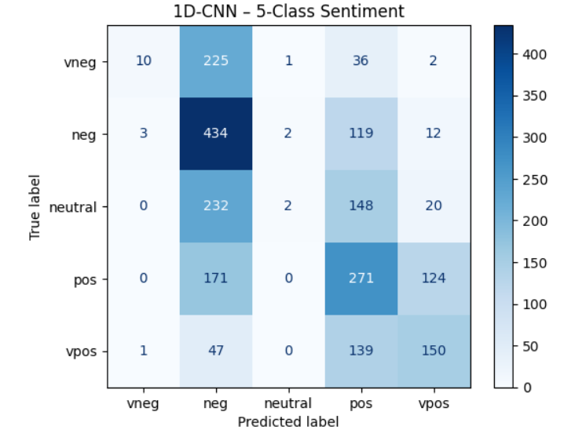
Quantitative Error Analysis
Neutral class confusion
Adjacent class errors
CNN precision–recall imbalance
Notes:
Metrics alone hide systematic errors, which we uncovered using confusion matrices and per-class metrics

Slide 13
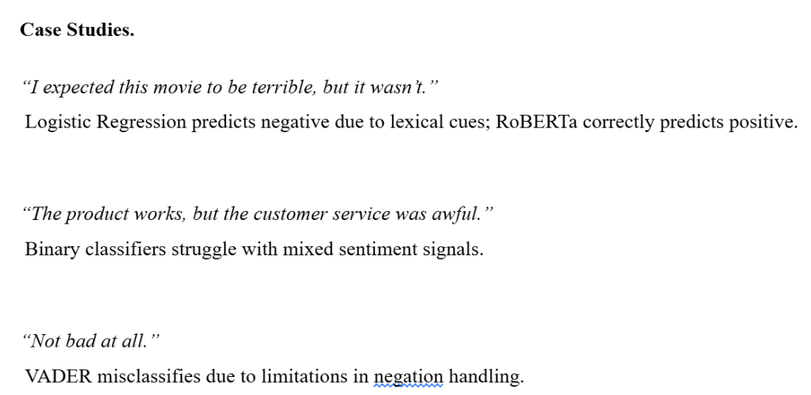
Qualitative Error Analysis
Sarcasm
Negation
Mixed sentiment
Notes:
Manual inspection shows that models fail differently — transformers handle negation and context better, while classical models rely on surface-level cues

Slide 14

Key Findings
01
Dataset size > architecture
Classical ML strong baseline
Transformers for nuance
02
03
Notes:
The key takeaway is to start simple and only increase complexity when justified by the task

Slide 15
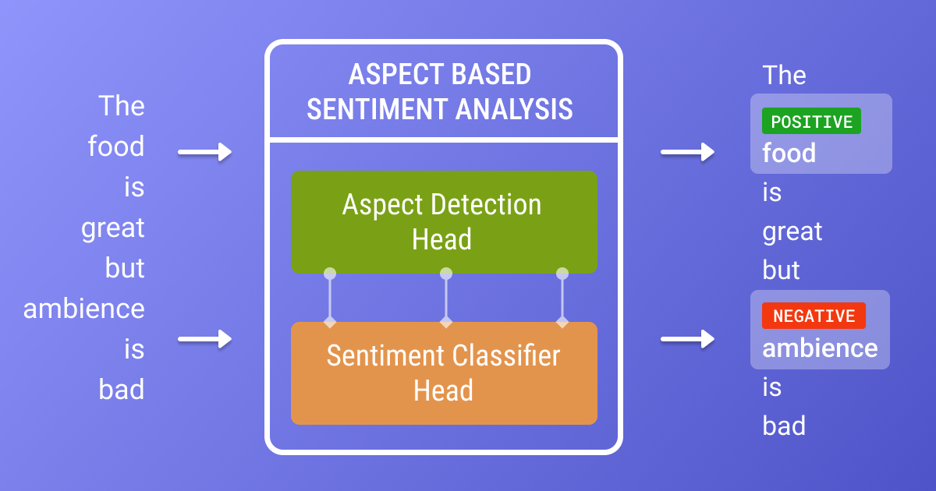
Aspect based sentiment
Cross lingual models
Hybrid approaches
Future work
Notes:
Future work could explore where transformer advantages are more pronounced.

Slide 16

Conclusion
Simpler models often suffice
Transformers are situationally useful

